Slide 1
IPL Stats Analysis
Problem Statement -
Create a infographic of IPL statistics (2008-2017) for IFP news agency for their newsletter.
Study team’s performance with respect to various factors such as Venue, Season, Toss decision and many more with the help of visualization.
Study player’s performance with respect to number of sixes, fours, total runs with the help of visualization.

Slide 2
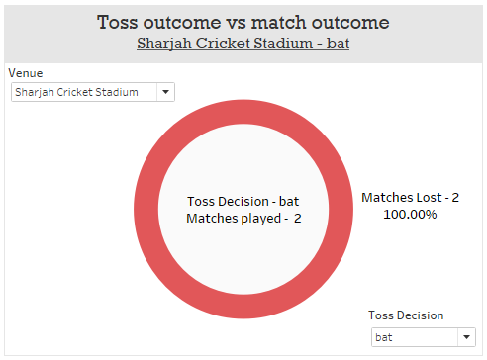
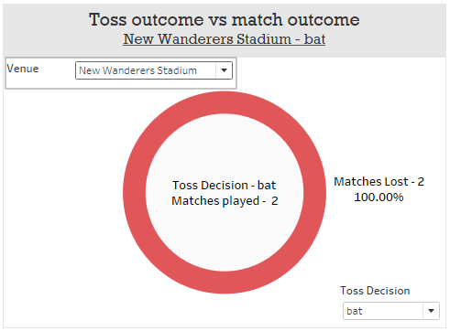
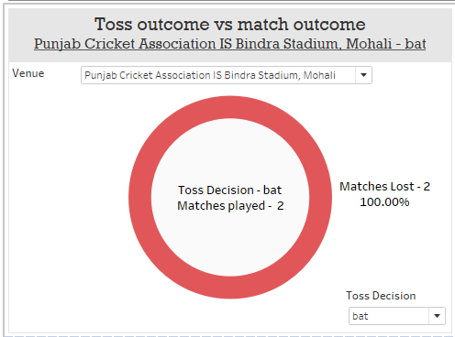
Toss Outcome vs. Match Outcome
Toss decision- Bat
It is clearly visible that toss winner shouldn’t opt to Bat first at following venues -
Sharjah Cricket Stadium
New Wanderers Stadium
Punjab Cricket Association IS Bindra Stadium, Mohali

Slide 3
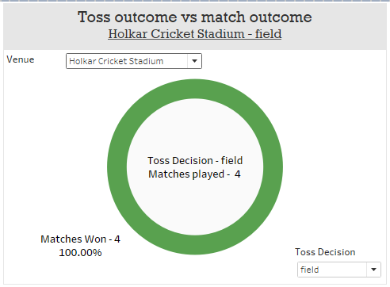
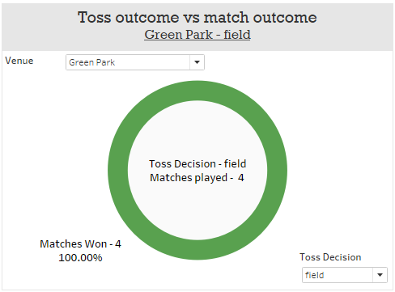
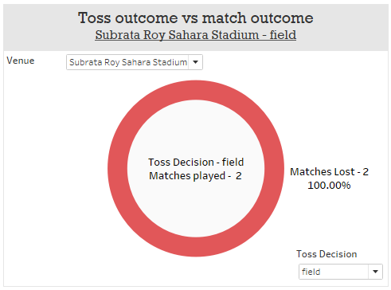
Toss Outcome vs. Match Outcome
Toss decision- Field
It is clearly visible that toss winner should opt to Field first at following venues -
Holkar Cricket Stadium
Green Park
While they shouldn’t opt to Field first at Subrata Roy Sahara Stadium.

Slide 4
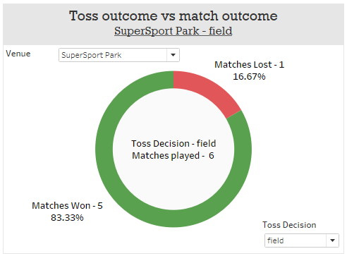
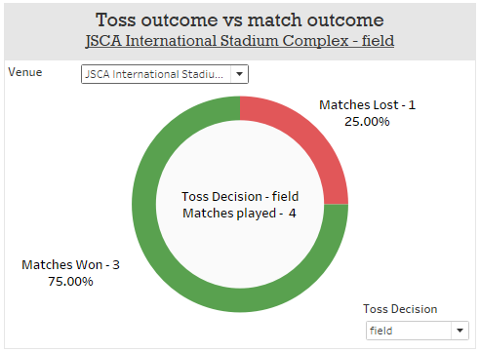
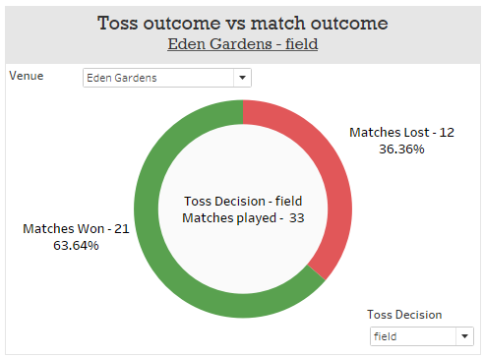
Toss Outcome vs. Match Outcome
Toss decision- Field
Chances of winning a match is high if toss winner opt to Field first at following venues-
SuperSport Park
JSCA International Stadium Complex
Eden Gardens

Slide 5
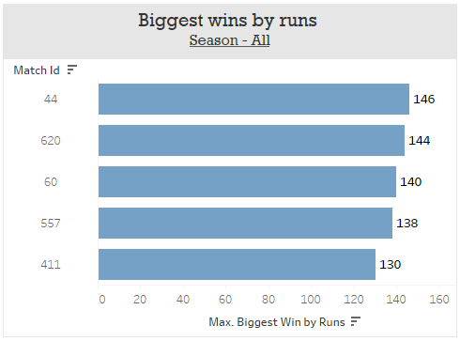
Biggest Wins by Runs
Season – 2017
Match – DD vs MI
Winner – MI
Venue - Firoz shah kotla
Season – 2016
Match – RCB vs GL
Winner – RCB
Venue - Chinnaswamy stadium
Season – 2008
Match – KKR vs RCB
Winner – KKR
Venue - Chinnaswamy stadium
Season – 2015
Match – RCB vs KXIP
Winner – RCB
Venue - Chinnaswamy stadium
Season – 2013
Match – RCB vs PW
Winner – RCB
Venue - Chinnaswamy stadium
Biggest win by runs (146 runs) came out for match - 44 held at Firoz Shah Kotla between Mumbai Indians & Delhi Daredevils.
Also most of the biggest win by runs came out at M Chinnaswamy Stadium and won by Royal Challengers Bangalore.

Slide 6
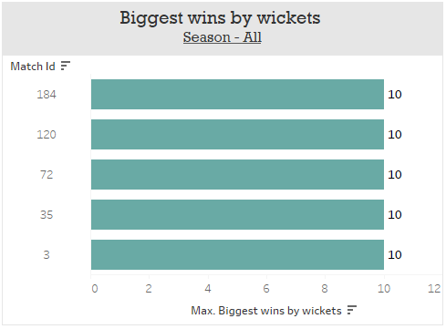
Biggest Wins by Wickets
Season – 2010
Match – RR vs RCB
Winner – RCB
Venue - Chinnaswamy stadium
Season – 2009
Match – KXIP vs DD
Winner – DD
Venue - Newlands
Season – 2008
Match – MI vs DC
Winner – DC
Venue - Dr DY Patil Sports Academy
Season – 2017
Match – DD vs KXIP
Winner – KXIP
Venue - Mohali, Punjab
Season – 2017
Match – GL vs KKR
Winner – KKR
Venue - Saurashtra Cricket Association
Top 5 biggest win by wickets (10 wickets) came out at above venues won by respective teams.

Slide 7
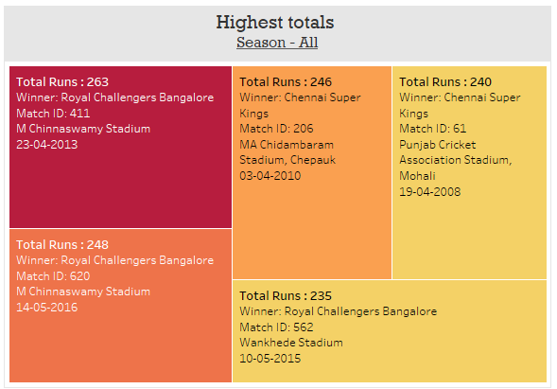
Highest Totals
Highest total ever observed in IPL was 263 runs by Royal Challengers Bangalore against Pune Warriors on M Chinnaswamy Stadium in 2013, where our favorite Universe Boss scored 175 runs all by himself.

Slide 8
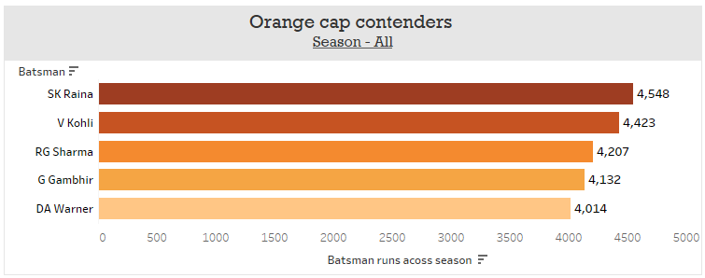
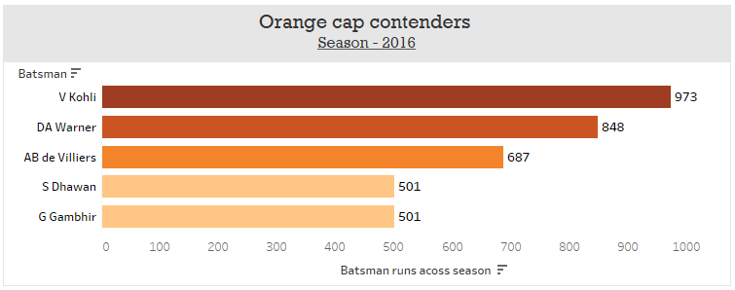
Orange Cap Contenders
When it comes to scoring runs no one can come close to Suresh Raina, actually Virat can but Raina is still the top run scorer of all time with 4548 runs.
But Virat Kohli has scored highest ever Runs for a single season by any batsman which is 973 runs in 2016.

Slide 9
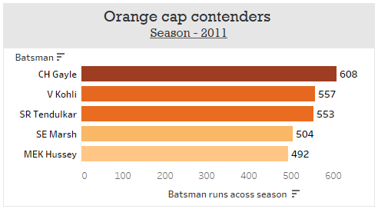
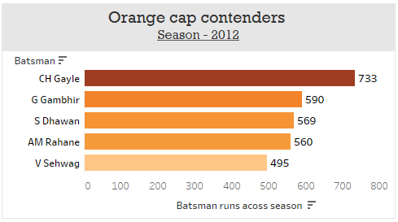
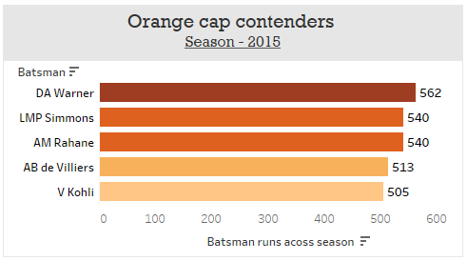
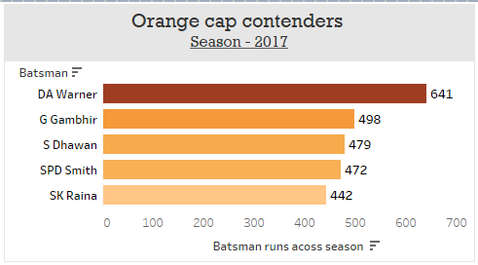
Orange Cap Contenders
Chris Gayle is the only player who has won Orange cap two times in a row for season 2011 & 2012.
David Warner has also been awarded with Orange cap two times for season 2015 & 2017.

Slide 10
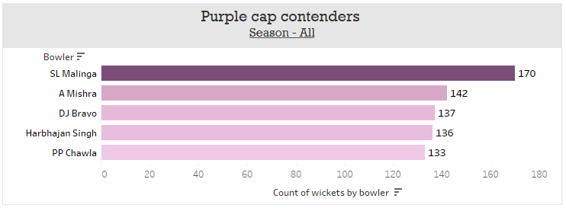
Purple Cap Contenders
Despite having unique action of bowling , SL Malinga has taken most wickets which 170 wickets overall, followed by-
A Mishra - 142
DJ Bravo - 137
H Singh - 136
PP Chawla - 133

Slide 11
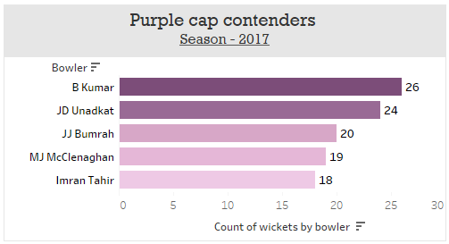
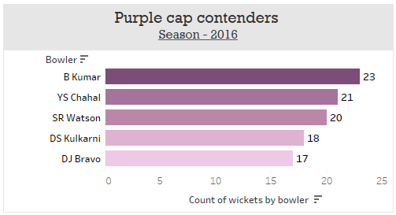
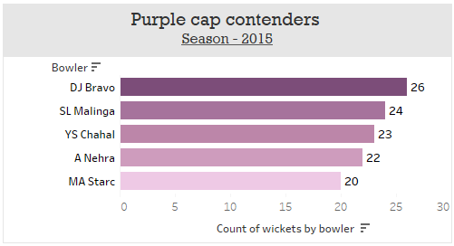
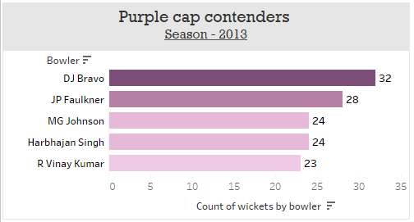
Purple Cap Contenders
B. Kumar and DJ Bravo won orange cap for two seasons each, while DJ bravo has taken most number of wickets for a single season which is 32 wickets in 2013.

Slide 12
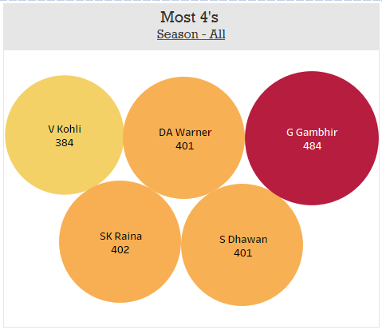
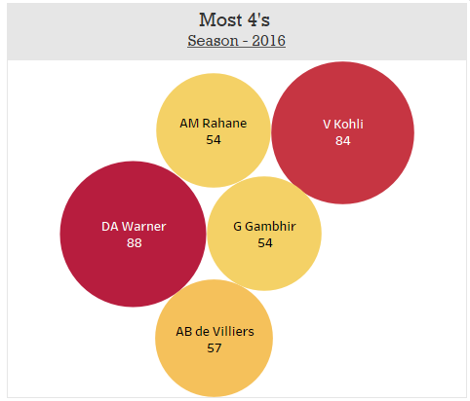
Most 4’s
Gautam Gambhir has hit most number of 4’s overall which is 484 fours, truly he is not that ‘Gambhir’ at all.
David Warner has hit most number of 4’s for a single season which 88 fours in 2016, but still he was not the orange cap winner for that season. RCB captain Virat Kohli who was 4 fours short by David Warner managed to be the orange cap winner for 2016.

Slide 13
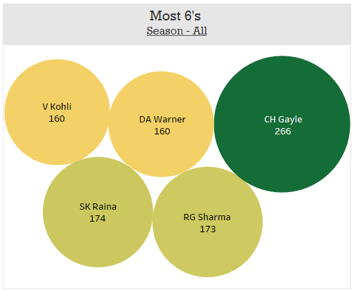
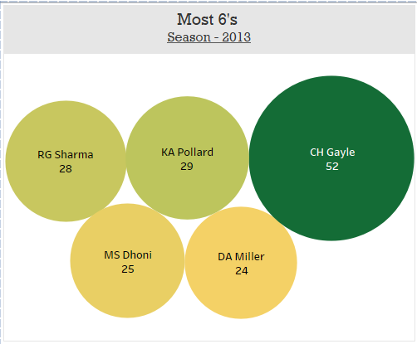
Most 6’s
Chris Gayle doesn’t stop when it comes to hitting balls out of stadium. He has hit most number of sixes overall (266 sixes) and for a season 2013 (52 sixes). Maybe that’s why he is Universe Boss !

Slide 14
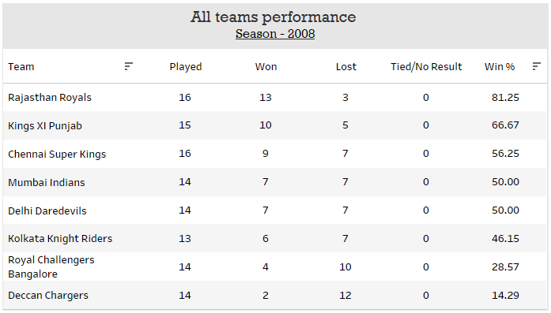
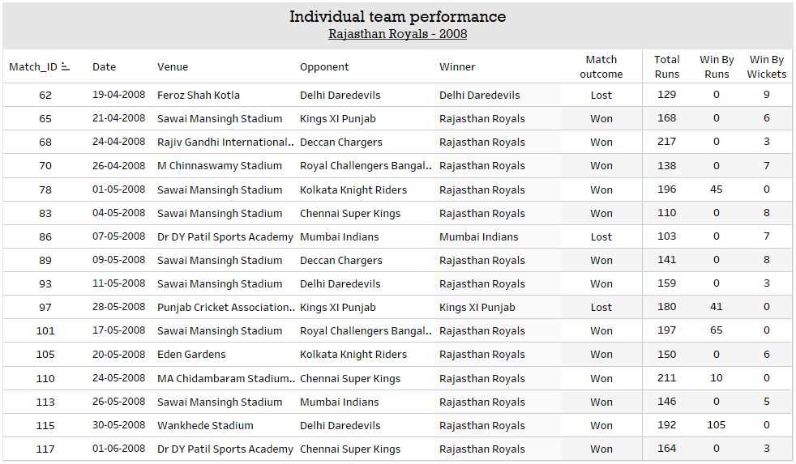
Team Statistics
Rajasthan Royals was on fire for season 2008 where they had highest winning percentage across all season by any team, 81.25%. Their overall season performance is also shown.

Slide 15
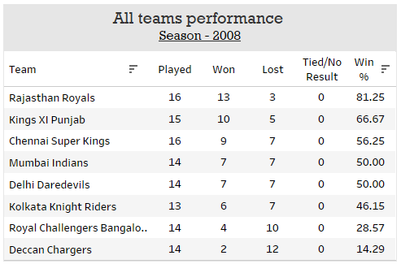
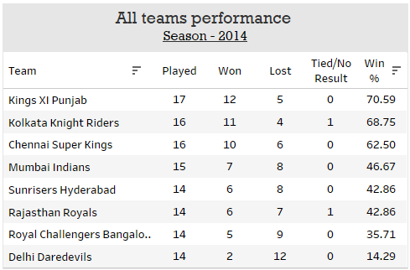
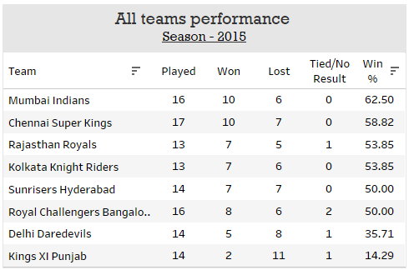
Team Statistics
Worst winning percentage
Deccan Chargers (2008), Delhi Daredevils (2014), Kings XI Punjab (2015) have worst winning percentage across all IPL seasons which 14.29% for each team.

Slide 16
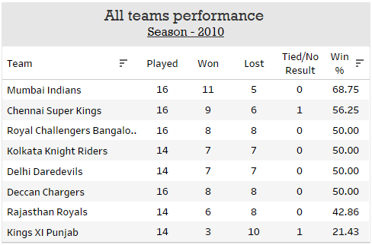
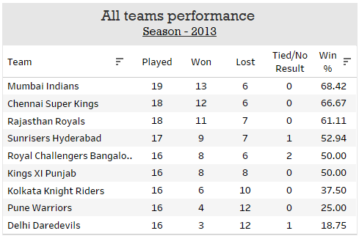
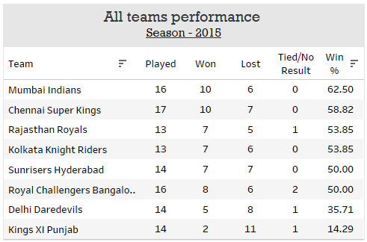
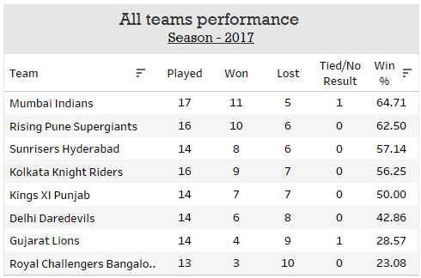
Team Statistics
Mumbai Indians is the only team to top the table for 4 seasons when it comes to winning percentage, maybe because there is word ‘India’ in their name.

Slide 17
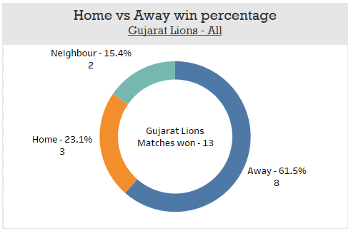
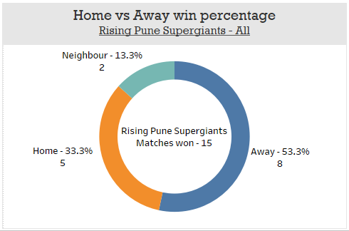
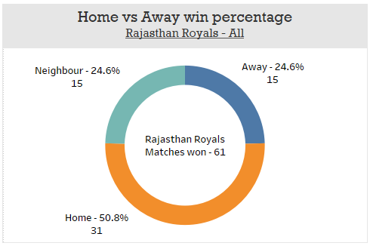
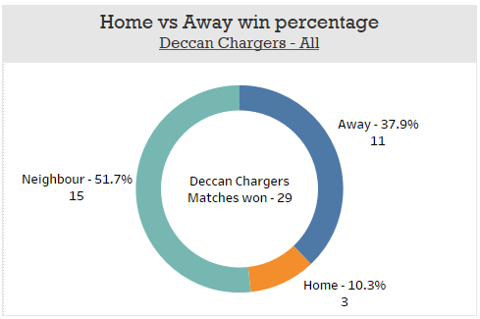
Home vs Away Win Percentage
Gujarat Lions and Pune Supergiants are the teams who have good results when they play matches on Away grounds.
Most number of matches won by Rajasthan Royals are on their Home ground.
Most number of matches won by Deccan Chargers are on Neighbor's ground (Neither Home nor Away).

